Slide 1
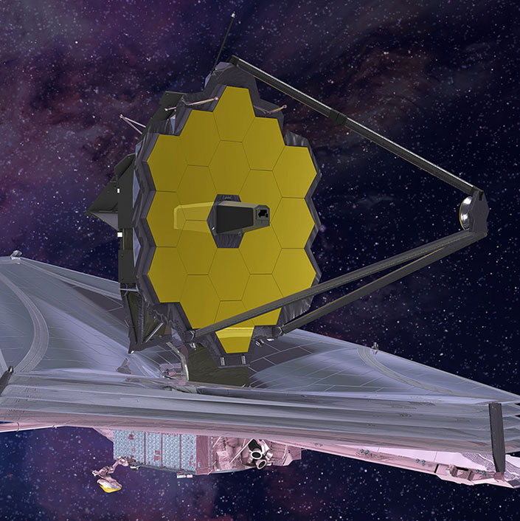
Space Technology
-- 19L31A05O8
-- CSE-4

Slide 2
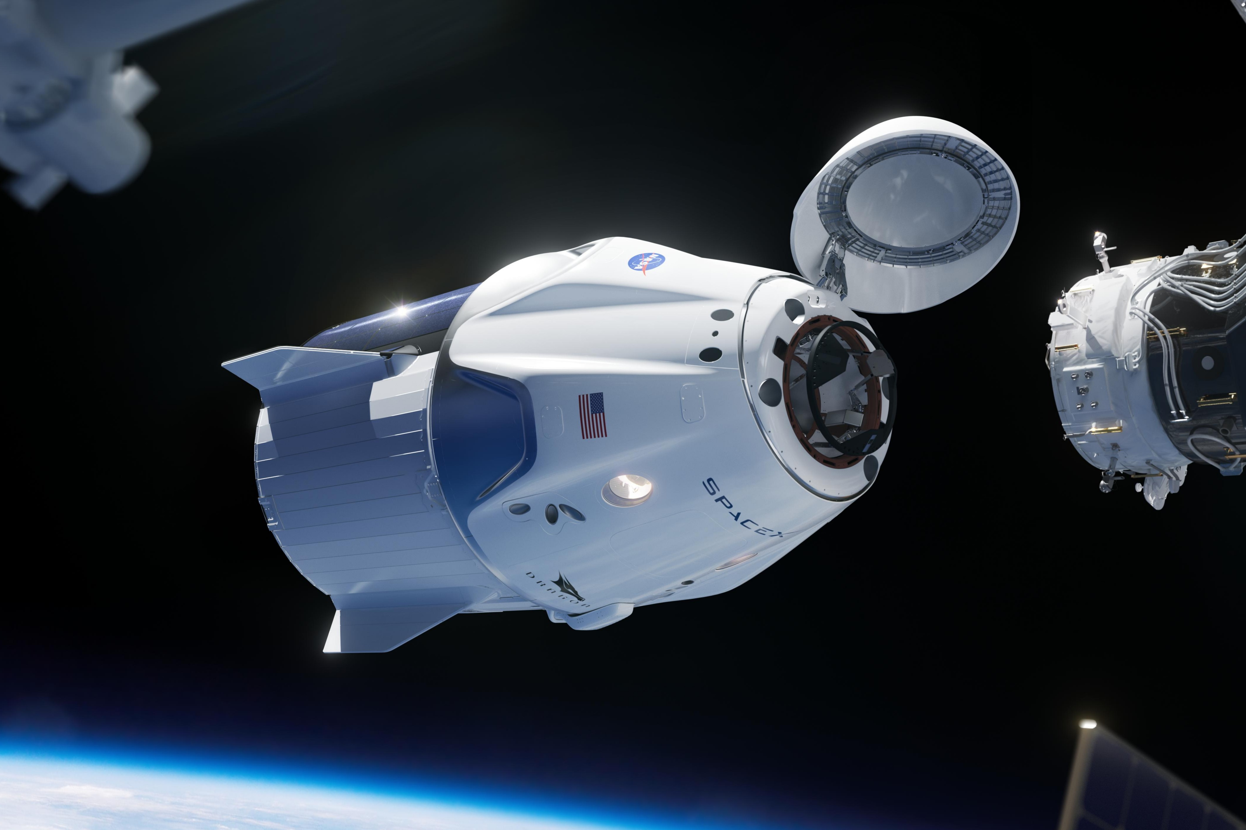
Space Technology
Space technology is technology for use in travel or activities beyond Earth's atmosphere, for purposes such as spaceflight or space exploration.

Slide 3
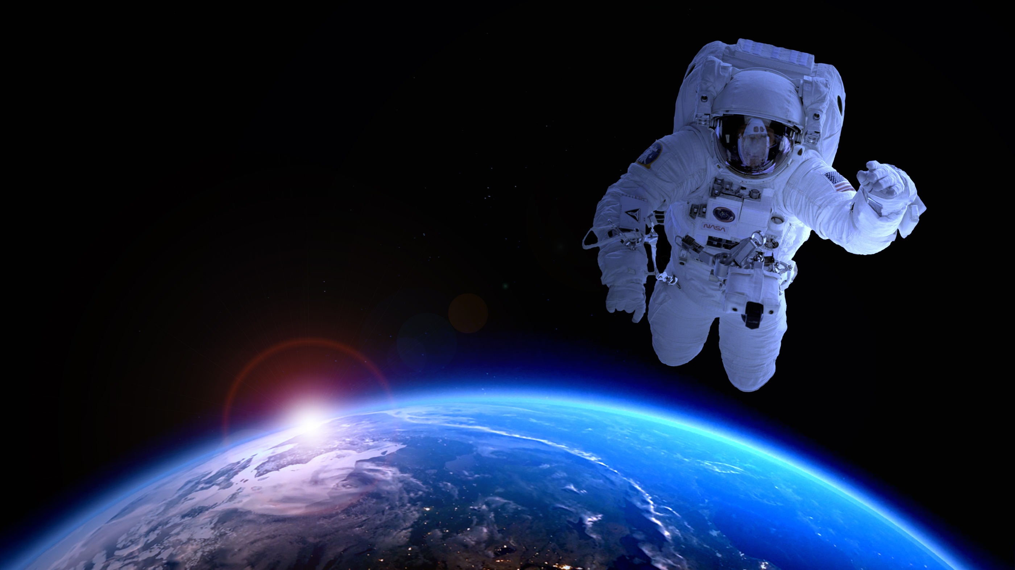
Why Space Technology
To know more about our universe.
To search for the existence of life outside our planet.
To become multi-planetary species.

Slide 4
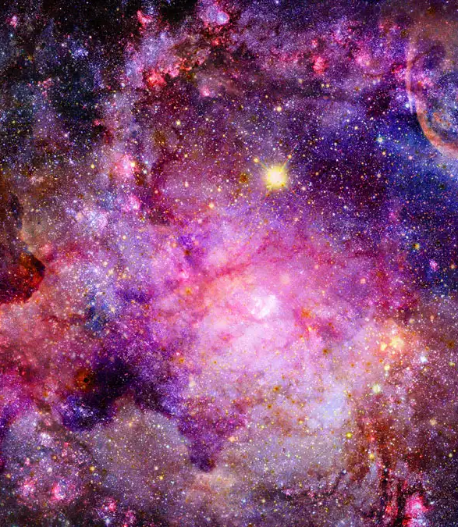
To know more about our universe
To know about formation of galaxies.
To know about Dark Matter and Dark Energy.
To know more about Big Bang.

Slide 5
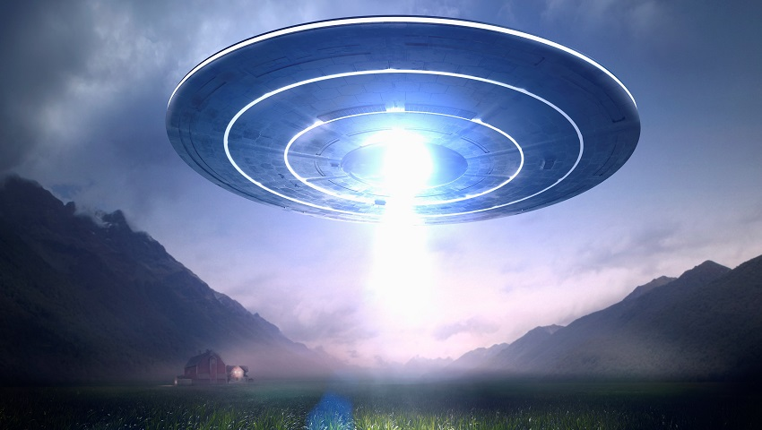
Extraterrestrial Intelligence Lifeform
To find aliens on different planet.
To find about alien technology.
To find more about beginning of LIFE.

Slide 6

To become multi-planetary species
It is necessary for us to become multiplanetary species to continue the existence of humanity.
This Photo by Unknown author is licensed under CC BY-SA.

Slide 7
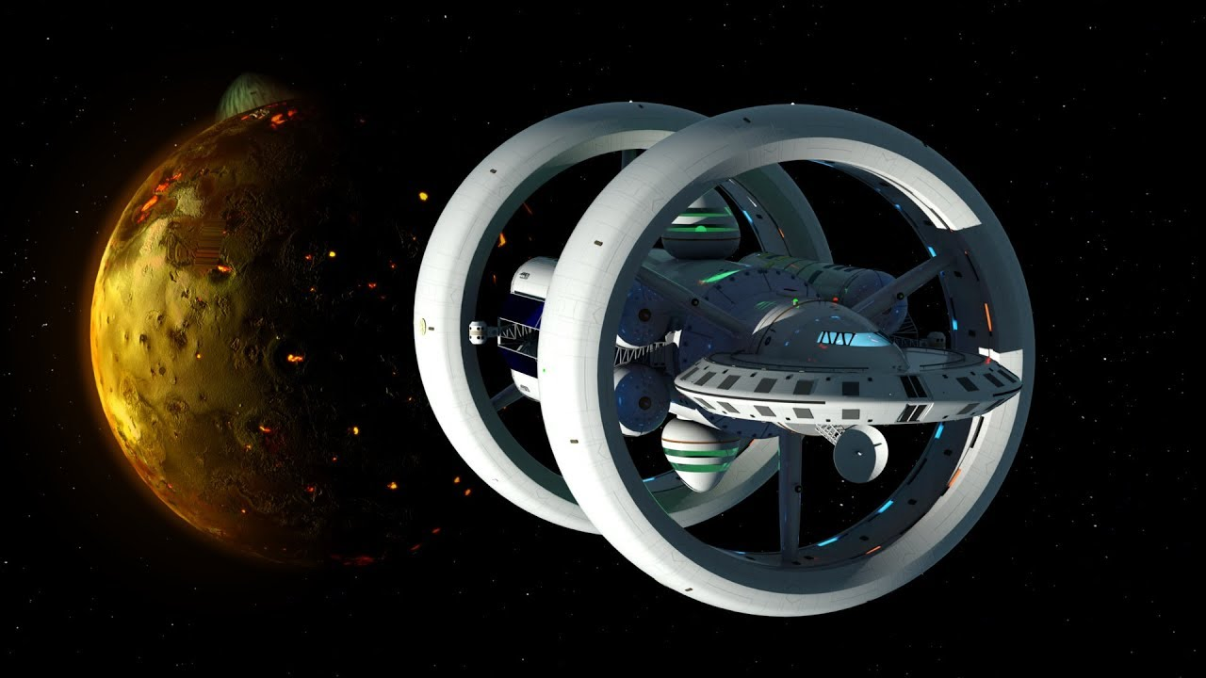
Some of the Recent Space Technology Devices
James Webb Space Telescope
Reusable Rockets
Wrap Drive Starship

Slide 8
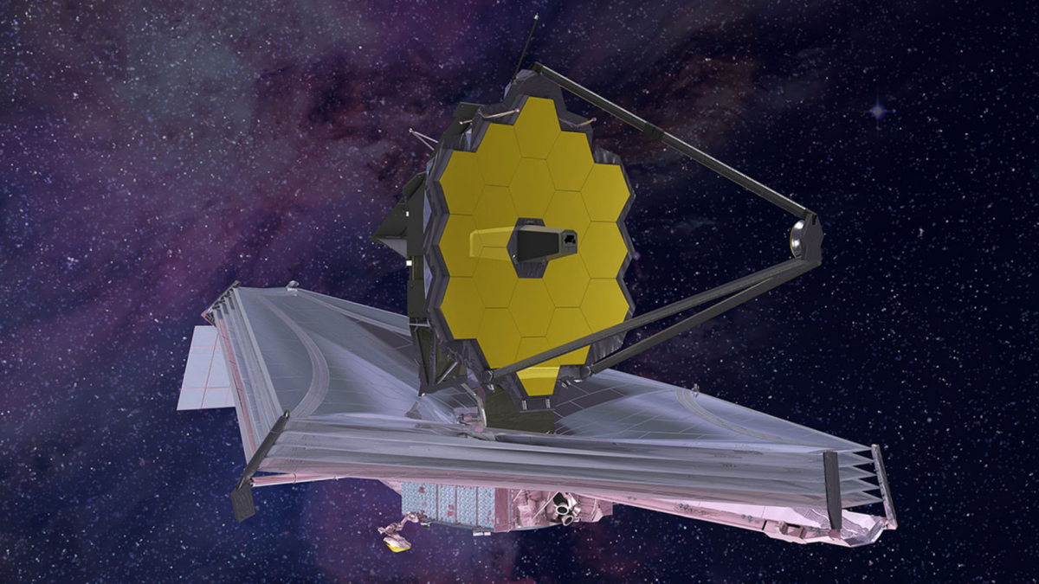
James Webb Space Telescope
The James Webb Space Telescope (JWST) is a space telescope designed primarily to conduct infrared astronomy.
The range of James Webb Space Telescope is 13.6 billion light years.
It revolves around the sun.

Slide 9
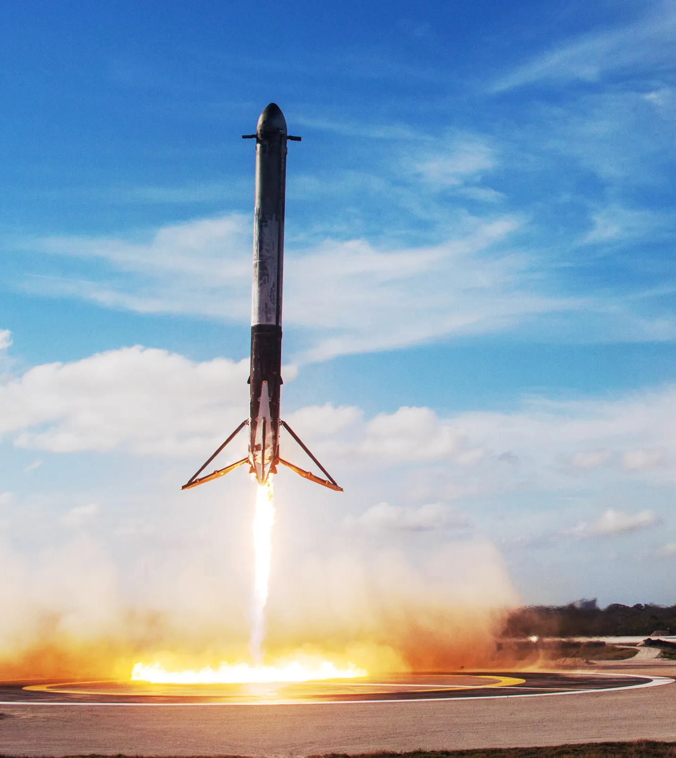
Reusable Rockets
Falcon 9 is the world's first orbital class reusable rocket designed by SpaceX.
Reusability allows us to reuse the most expensive parts of the rockets.
The goal of SpaceX is to reduce the cost by reusing rockets.

Slide 10
Wrap Drive Starship
A Spaceship which travels at light speed.
It bends space to travel at light speed.
It's the future technology to travel Galaxies.

Slide 11
THANK
YOU

